Slide 1
ANN : Number Recognition
CI – Prof. George Papadourakis, Ph.D.
Trivizakis Eleftherios MP143, Tzagkarakis Konstantinos MP141

Slide 2
Introduction
User inputs a number
In real-time
The application is using an Artificial Neural Network (ANN)
After a number of Epochs
ANN learning process
The number can be identified

Slide 3
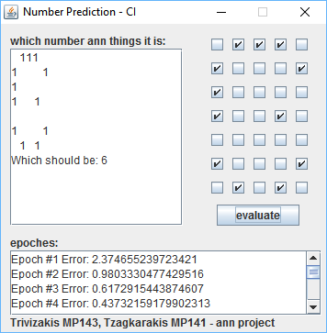
Tools & Development
Eclipse
Integrated Development Environment
JDK
Java Development Kit
Encog Library
Open Source API for ANN
GUI

Slide 4
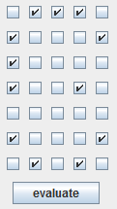
Definition of the Problem - Application
An implementation of ANN to identify (0-9)
Actual input, an array 7*5 that represents a number
User Input:
Even a distorted number
Output:
An estimation of 0-9

Slide 5
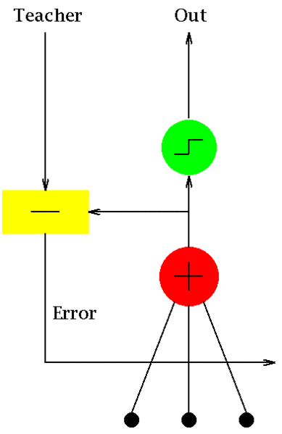
Details About ANN Implementation
uses ADALINE
Adaptive Linear Neuron
single-layer artificial neural network
η is the learning rate (some positive constant)
y is the output of the model
o is the target (desired) output
w ← w+η(o-y)x
converges to the least squares error Ε=(ο-y)^2

Slide 6
DATA

Slide 7
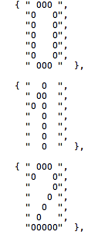
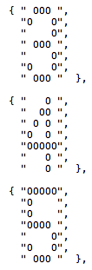
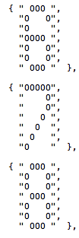
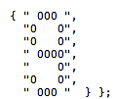
Creating Training Data
Ideal Input Numbers

Slide 8
converging to the least squares error Ε=(ο-y)^2
Epoch #1 Error: 3.272442442077678
Epoch #10 Error: 0.2164587518157666
Epoch #20 Error: 0.09713159846618982
Epoch #30 Error: 0.05112612225279274
Epoch #40 Error: 0.028530579283774542
Epoch #50 Error: 0.016433273353919746
Epoch #60 Error: 0.009665126410289753
Final error value for our ann: 0.009665126410289753

Slide 9
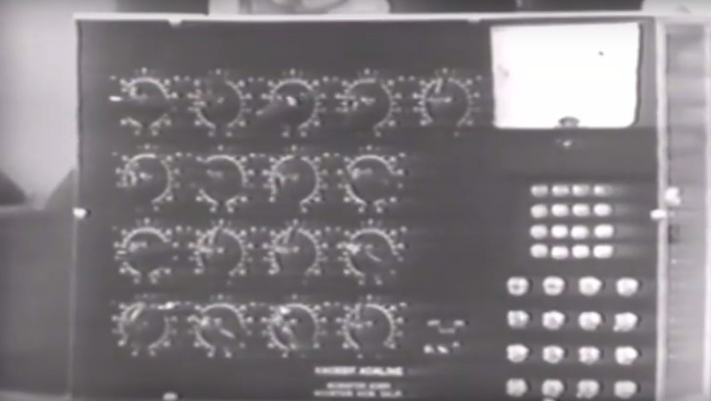
A Cool Comparison
Past
Present

Slide 10
How It Works?
Initialize the ANN
How many inputs
How many outputs
Learning rate
Define the ideal target
the array that represents number
Generate training dataset
Using high level object
User Input
Test Input

Slide 11
References
http://neuroph.sourceforge.net/
http://www.heatonresearch.com/aifh/vol3/
https://github.com/encog/encog-java-core/releases
http://www.cs.utsa.edu/~bylander/cs4793/learnsc32.pdf
http://neuralnetworksanddeeplearning.com
https://www.youtube.com/watch?v=IEFRtz68m-8

Slide 12
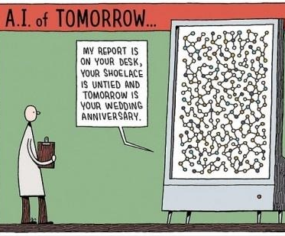
Thx!

